Slide 1
Balance between IPR and Competition for Promoting Innovation
Eduardo Pérez Motta
November 10th 2017

Slide 2
Index
1
Why focus on innovation?
2
Intersection between IPR and Competition
3
A glance at the current IPR and Competition systems
4
Moving towards the right balance

Slide 3
Index
1
Why focus on innovation?
2
Intersection between IPR and Competition
3
A glance at the current IPR and Competition systems
4
Moving towards the right balance

Slide 4
Innovation is fundamental for sustainable development…
1
Social
impact
Access to appropriate technologies improves living conditions.
Economic impact
Innovation drives productivity gains, rising incomes.
Driver of prosperity and competitiveness.
Sustainable and inclusive development is incomplete without consideration of science, technology and innovation
innovation
invention
Developing & putting in practice new ideas (Value creation)
Developing new ideas/knowledge. Not necessarily implemented.

Slide 5
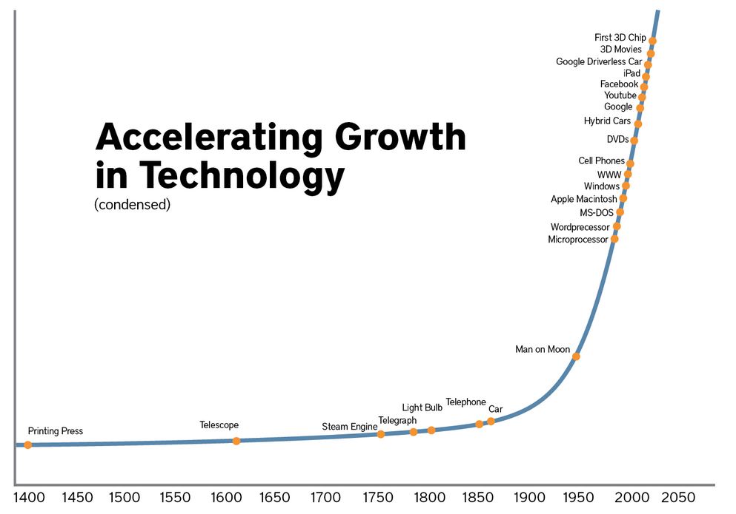
Source: Asgard Capital Verwaltung

Slide 6
Balance between IPR and market competition is a key component of an innovation-friendly ecosystem…
1
…along with:
stability and well-functioning institutions
an educated workforce
sound research and education infrastructure
linkages between public and private actors
enterprises committed to R&D
IPRs and Competition are two of several mechanisms to promote innovation.

Slide 7
Index
1
Why focus on innovation?
2
Intersection between IPR and Competition
3
A glance at the current IPR and Competition systems
4
Moving towards the right balance

Slide 8
IPR and Competition may seem contradictory, but share common rationales…
2
Intellectual Property Law
Competition Law
Grants temporary monopoly rights.
Combats monopolistic behaviours.
Common objective: stimulating innovation, economic growth and consumer welfare.
IPR
Innovation
Competition

Slide 9
Innovation: some examples of Competition and IPR in action
2
Fintech Revolution
$
From Retail to
E-Commerce
TRIPS and Public Health

Slide 10
The Competition-IPR Overlap represents challenges…
2
Competition
IPR
Temporary Monopoly Rights
Competitive markets
Innovation
Consumer welfare
…IPR holders should not abuse their rights.
…value of protection should not be outweighed by social costs.
…uncertainty and regulatory complexity should not hamper innovation and investment.
etc.

Slide 11
What do IPR-Competition common challenges look like?
2
patent thickets
patent trolls and privateers
patent hold-ups and ambush (SEPs)
overbroad or extended protection, etc.
Due to:
Ambiguity and uniform approach to “patentability” scope and duration
Inadequate examination
Ineffective enforcement against IPR abuse.
Results in:
Reduced innovation and net welfare
Companies divert resources away from R&D (and into lobbying and lawsuits).
Future market entrants restrained and discouraged.

Slide 12
Index
1
Why focus on innovation?
2
Interface between IPR and Competition
3
A glance at the current IPR and Competition systems
4
Moving towards the right balance

Slide 13
A glance at the international IPR system…
3
WIPO
(191 Members)
TRIPS Agreement
(164 Members)
National IP regimes
Administers multilateral agreements:
Paris Convention
Berne Convention (literary & artistic works), etc.
and international protection systems on all forms of IP.
Multilateral trade agreement on all forms of IP
Incorporates Paris & Berne Conventions.
Minimum standards of protection & enforcement.
Dispute Settlement under WTO system.
Laws and Authorities, influences by intl obligations and flexibilities.
Regional Trade Agreements
Varying commitments, including TRIPS Plus obligations.

Slide 14
A glance at the international Competition system…
3
Multilateral Framework
Regional Framework
Other Intl Developments
No binding instrument
WTO Singapore Issues (Interaction Trade-Competition Policy)
Havana Charter
FTAs & Interagency Cooperation Agreements
From basic to ambitious:
NAFTA
Australia – NZ
European Union
ICN – OECD – UNCTAD
Networking
Best practices
Guidelines and Recommendations
Capacity building
National Competition Regimes
Laws and Authorities: varying degrees of maturity, enforcement & advocacy

Slide 15
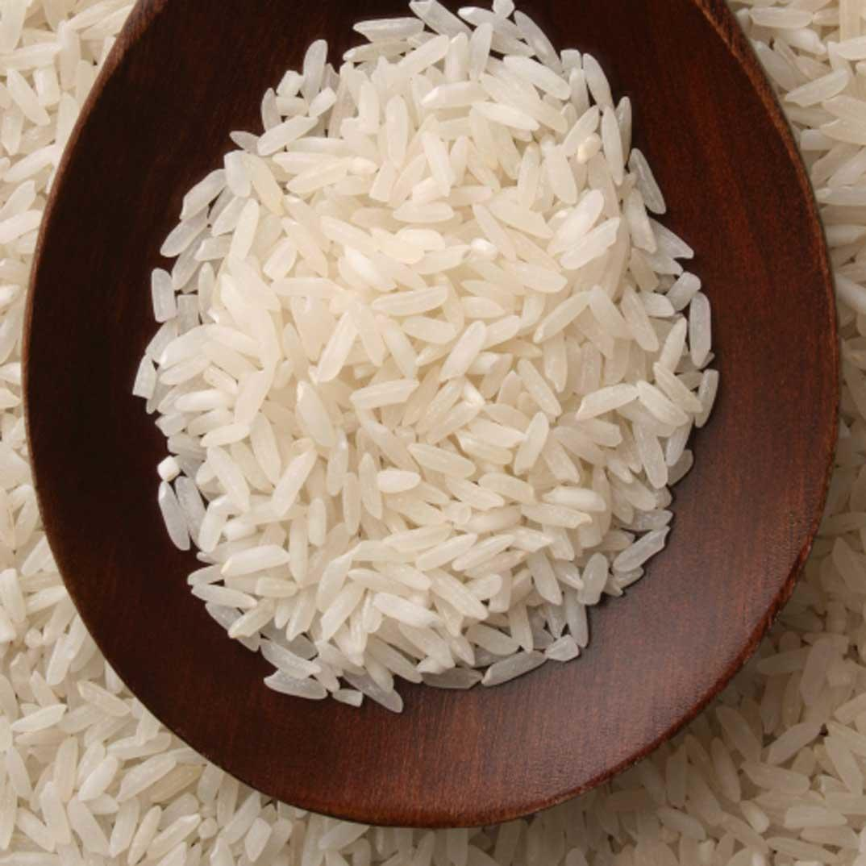
An example of how ambiguous criterion and inadequate examination of applications can lead to unjustified patents…
3
The US Patent and Trademark Office granted patents to American companies for Turmeric (1993) and Basmati rice (1994).

Slide 16
Index
1
Why focus on innovation?
2
Interface between IPR and Competition
3
A glance at the current IPR and Competition systems
4
Moving towards the right balance

Slide 17
Achieving the right balance to respond to such challenges requires injecting Competition principles into IPR implementation…
4
Ideas for International Action (long term)
Conduct further Research
What does the evidence actually say on the co-relation or causal relation between IPR-Innovation-Competition?
More patent applications and grants ≠ more innovation.
Better defining what is patentable
What merits protection? Further clarify “Patentable Subject Matter” to address ambiguity that ? (TRIPS Art.27.1)
Overbroad protection due to loose standards hinders innovation.
Consider scope & duration of patent protection
Is the current uniform approach suitable and desirable? Would some differentiation benefit innovation?
Levels of tariff protection vary; so could IP protection.

Slide 18
…injecting Competition principles into IPR implementation…
4
Ideas for Domestic Action by Competition Agencies
Advocacy
Raising awareness on the importance that IPR do not unjustifiably harm competition.
Opinions about specific IP cases and IP norms’ wider market impact.
Identify regulations that hamper competition (even after patents expire).
MDs shall prescribe generics
Tackle burdensome sanitary registration procedures, formalities, etc.
Avoid delays: generics testing shall start ASAP
Generics
Enforcement
Strict vigilance of licensing practices and use of IPR (market power abuse).
Essential Facilities norms for Standard-Essential-Patents (SEPs).
Act against illegal protection-extensions.
Combat bid rigging in public procurement
Generics

Slide 19
…injecting Competition principles into IPR implementation…
4
Ideas for Joint Action by IPR and Competition Agencies
Enhance inter-agency relation
MOUs: formally promote joint activities and give political relevance to the interface.
Networking: harness complementarities and address common challenges.
Joint analysis of common challenges
Workshops and advocacy among IP and Competition agencies, academic and legal communities, stakeholders.
Joint opinions and studies (all angles of the intersection)
Soft Law instruments
Joint guidelines and criterion.
Building strong ex-ante position to help address joint challenges coherently.

Slide 20
Conclusions
Competition and IPR should work in favour of innovation and consumer welfare, but tensions constantly arise.
As innovation and technology play an increasingly vital role in development, closer attention must be paid to the IPR-Competition interface.
IPR are means to stimulate innovation, but IPR abuse harms innovation. Competition principles should be considered in IPR implementation to achieve a right balance.
Proposals involving the legitimate use of existing flexibilities nationally (competition advocacy & enforcement, inter-agency coordination) should be implemented in the short-term.
Proposals involving re-evaluation of international IPR legal instrument should be part of long-term strategy, but discussions should start now.

